Slide 1
General Examination

Slide 2

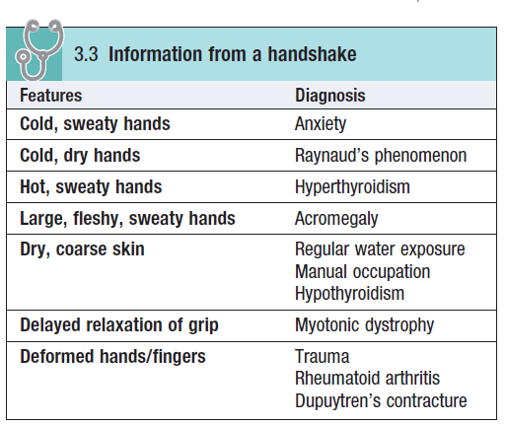

Slide 3
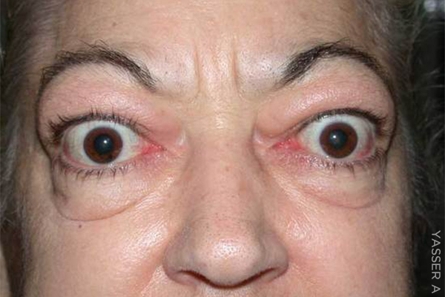

Abnormal Facial Expressions
Startled expression
Poverty of expression

Slide 4

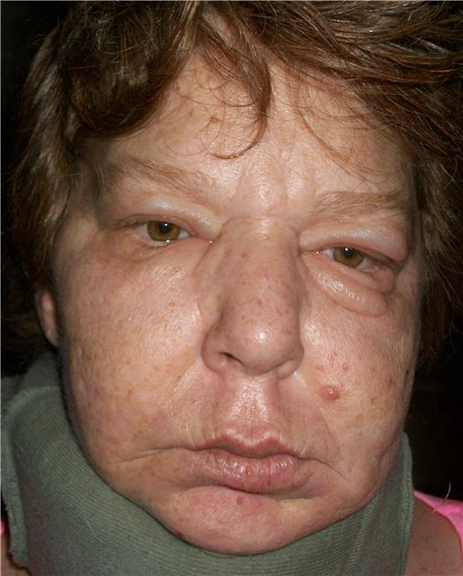
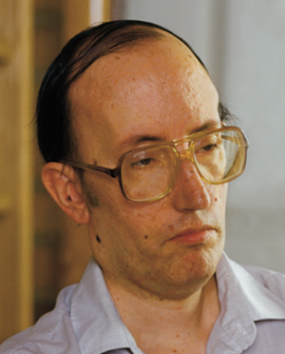
Apathy, with poverty of expression
and poor eye contact
Apathy, with pale and puffy skin
Lugubrious expression with bilateral ptosis

Slide 5
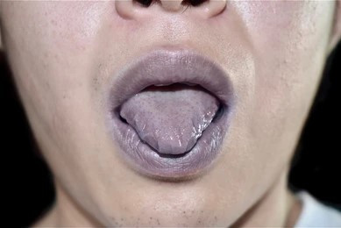
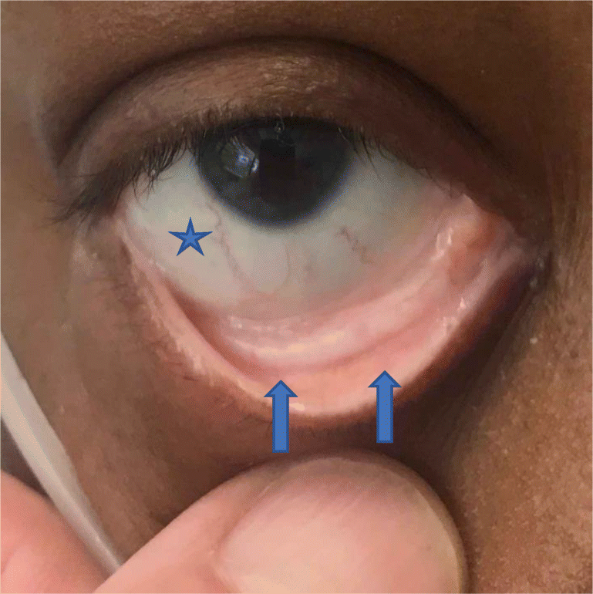
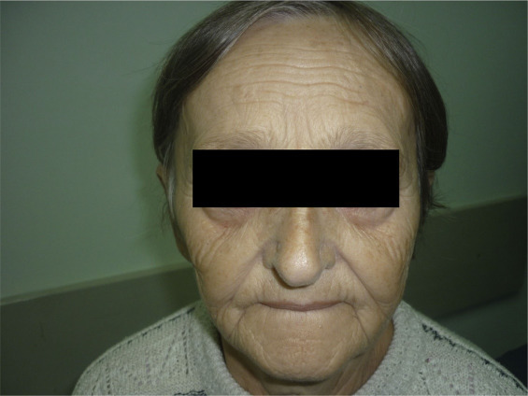
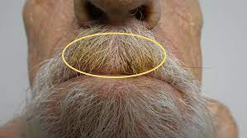
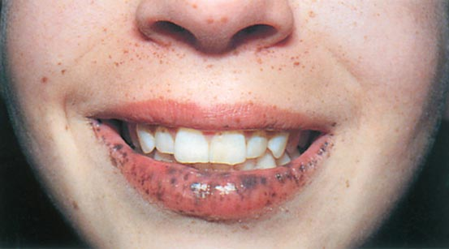
Notes:
Cyanosis is a blue discolouration of the skin and mucous membranes that occurs when the absolute concentration
of deoxygenated haemoglobin is increased
Central cyanosis
This is seen at the lips and tongue. It corresponds to an arterial oxygen saturation (SpO2) of <90% and usually indicates underlying cardiac or pulmonary
disease. Anaemic or hypovolaemic patients rarely have central cyanosis because severe hypoxia is required to produce the necessary concentration of deoxygenated haemoglobin. Conversely, patients with polycythaemia can become cyanosed at normal arterial oxygen saturation.
Peripheral cyanosis
This occurs in the hands, feet or ears, usually when they are cold. In healthy individuals, it appears in cold conditions when prolonged peripheral capillary flow allows for greater oxygen extraction and, consequently, increased levels of deoxyhaemoglobin.
In combination with central cyanosis, it is most often seen with poor peripheral circulation due to shock, heart failure, vascular disease and venous
obstruction, e.g. deep vein thrombosis.

Slide 6
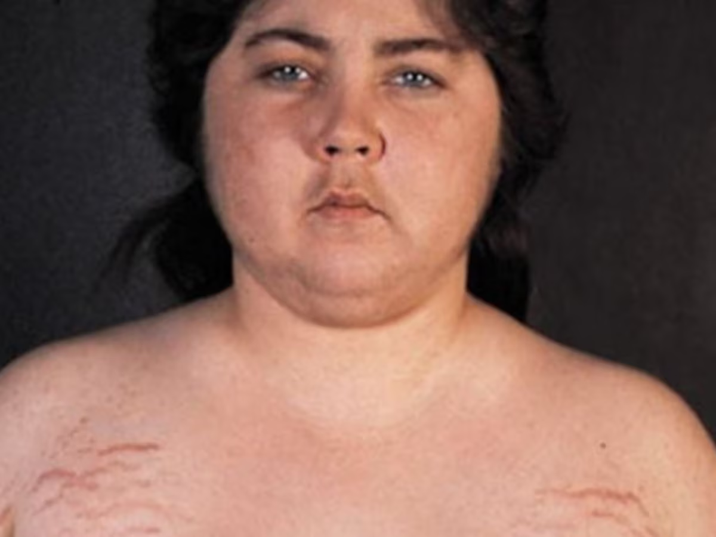
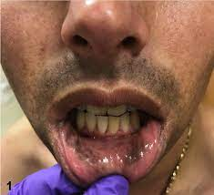

Slide 7
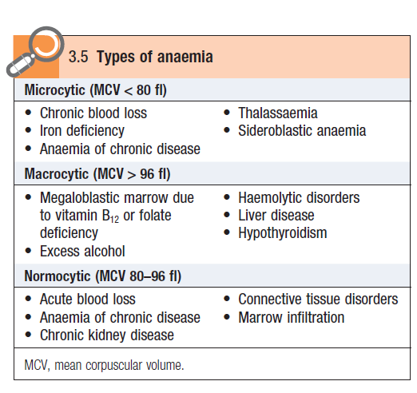

Slide 8
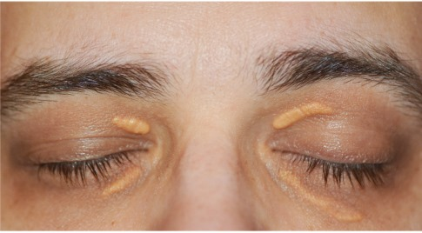
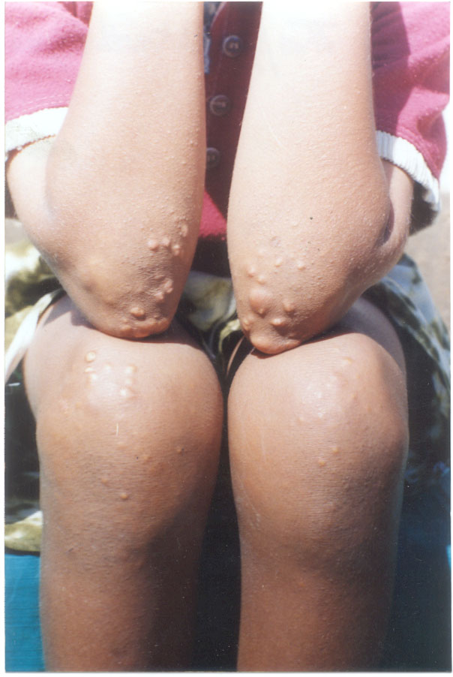
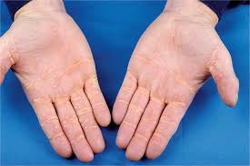
Notes:
xanthelasma

Slide 9
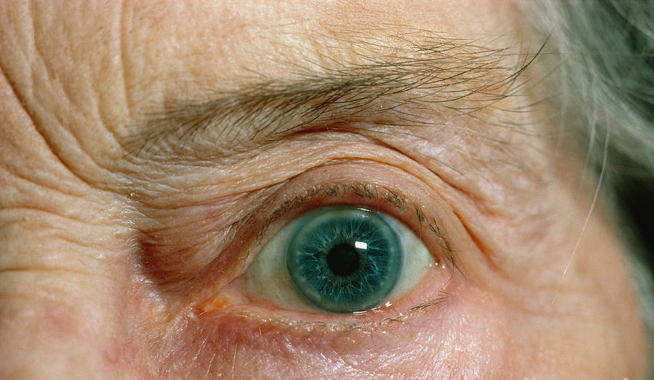
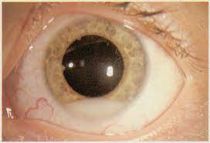
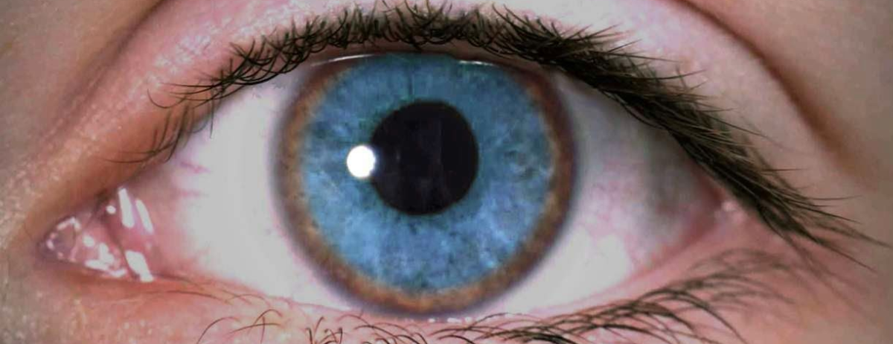
Notes:
Arcus Senilis
Hypopyon
Kayser-Fleischer Rings autosomal recessive inherited dysfunction of the ATP7B copper transporter, whereby copper is unable to be excreted in bile. Instead it builds up in the liver and eventually spills into the blood. The copper then deposits in tissues and causes damage. Two of the more common sites are the liver and brain, with resultant cirrhosis and neuropsychiatric effects.

Slide 10
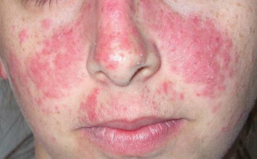
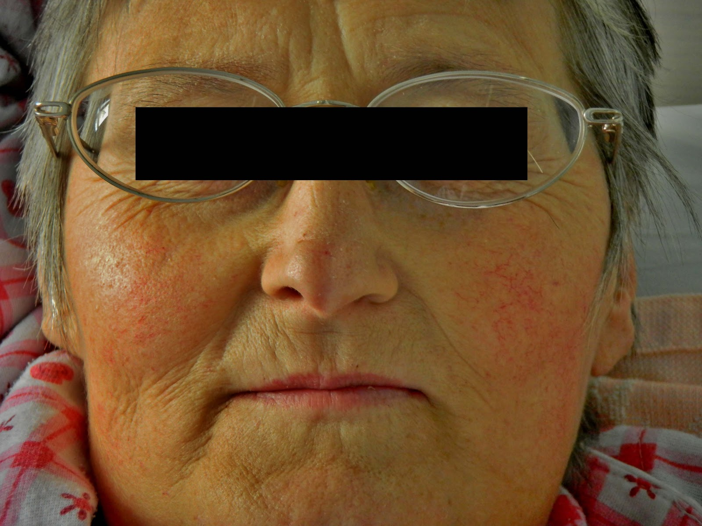
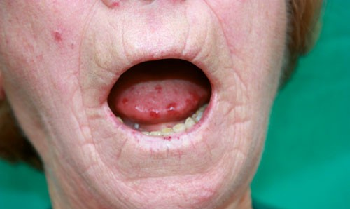
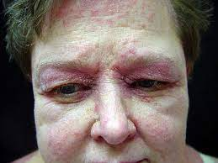

Slide 11
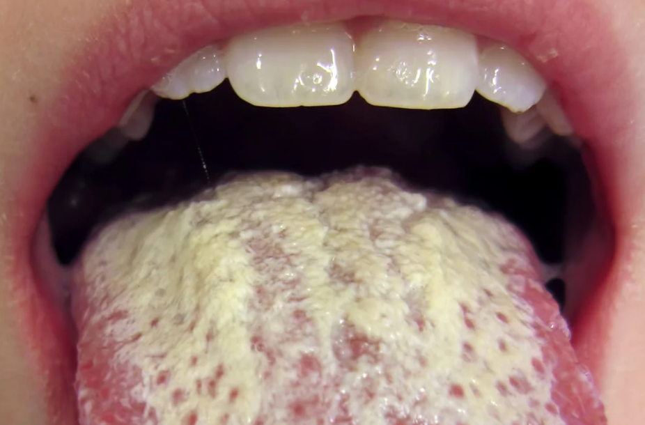
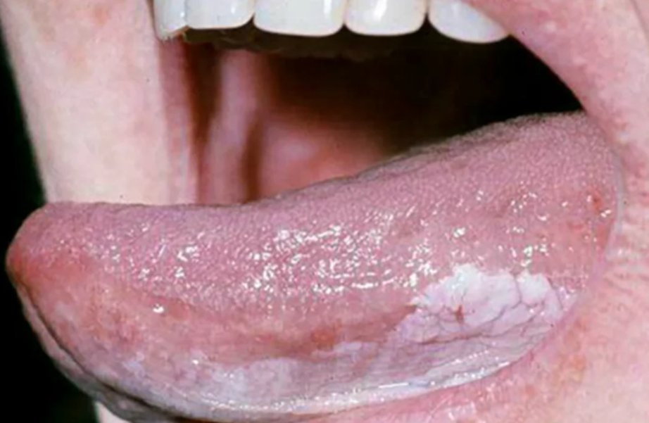
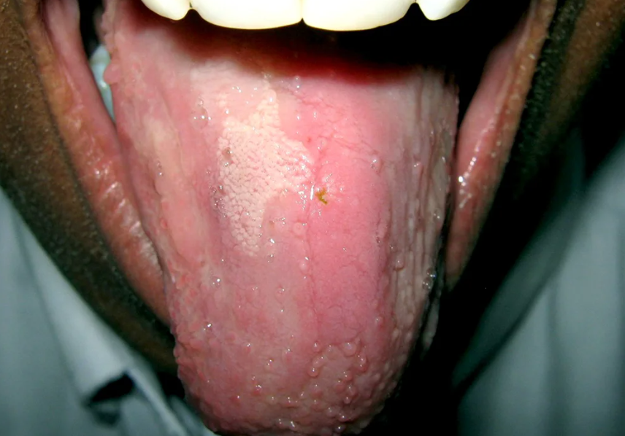
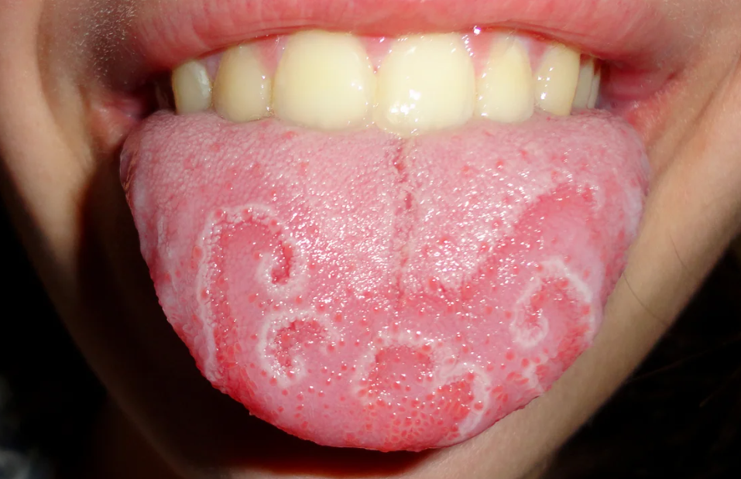
Notes:
Oral Thrush
Leukoplakia → Precancerous
Geographical tongue →is benign and asymptomatic -→ Sometimes seen in Psoriasis
Glossitis-→ Vitamin B deficiency

Slide 12
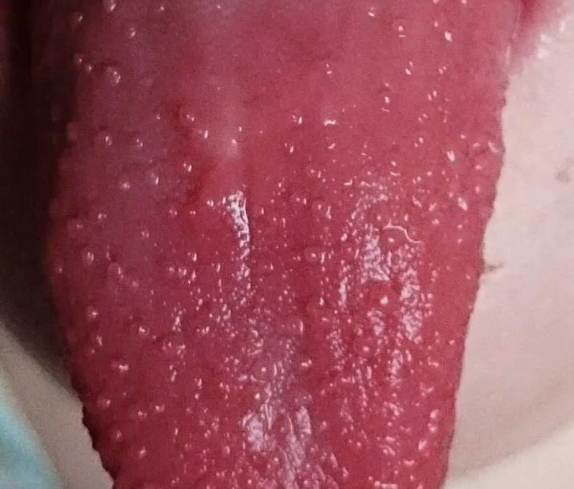
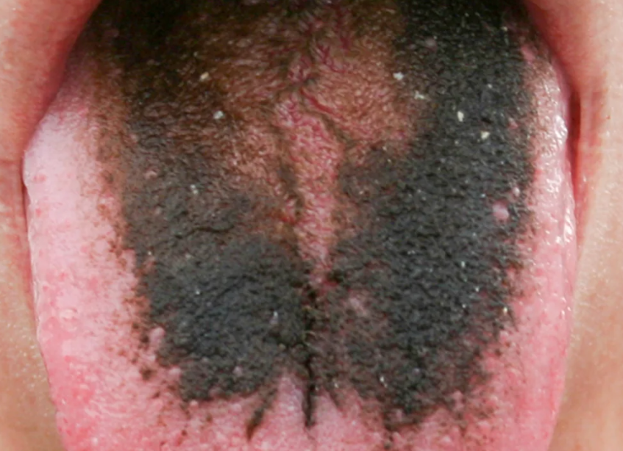
Notes:
Strawberry tongue-→ Scarlet fever and Kawasaki Disease
Hairy tongue-→ poor oral hygiene and smoking

Slide 13
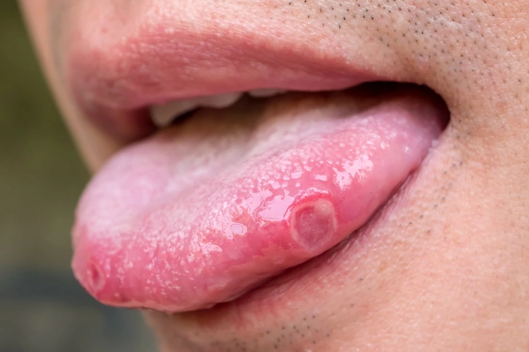
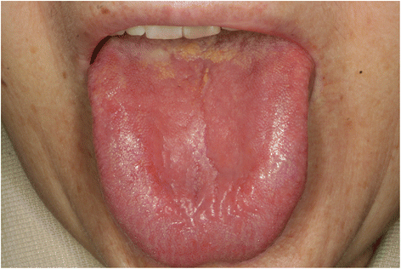

Slide 14
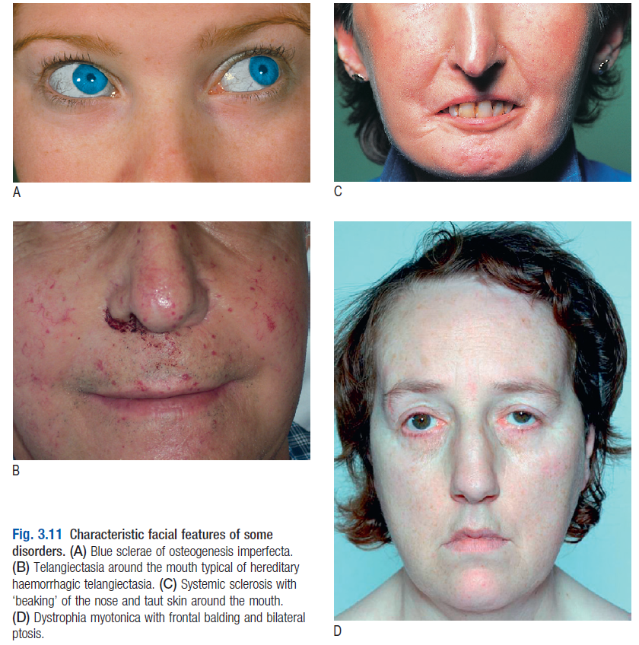

Slide 15
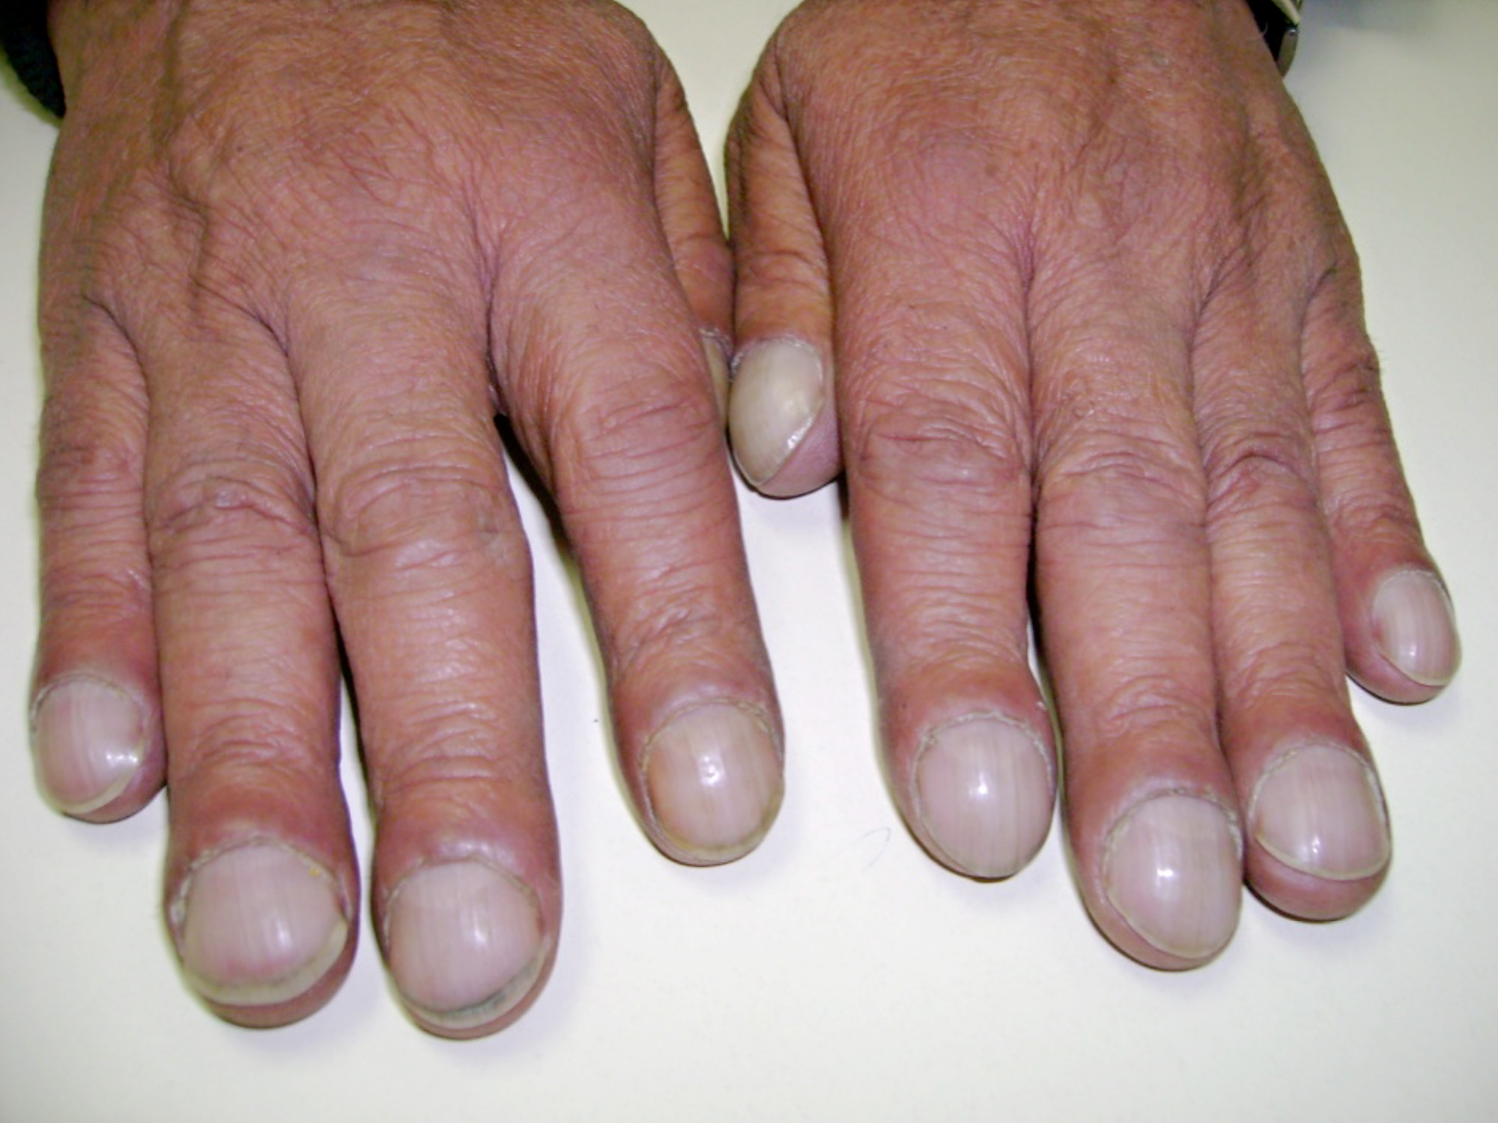
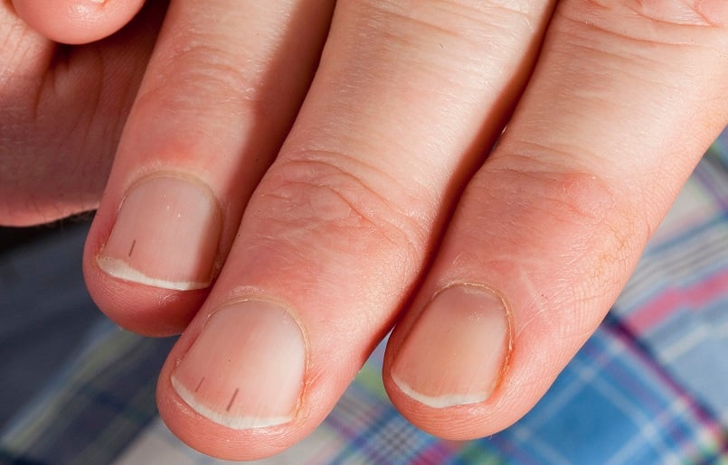
Notes:
Grade 1: Nail bed fluctuation. Grade 2: Obliteration of the Lovibond angle. Grade 3: Parrot beaking. Grade 4: Hypertrophic osteo-arthropathy (HOA).
Splinter Haemorrage

Slide 16
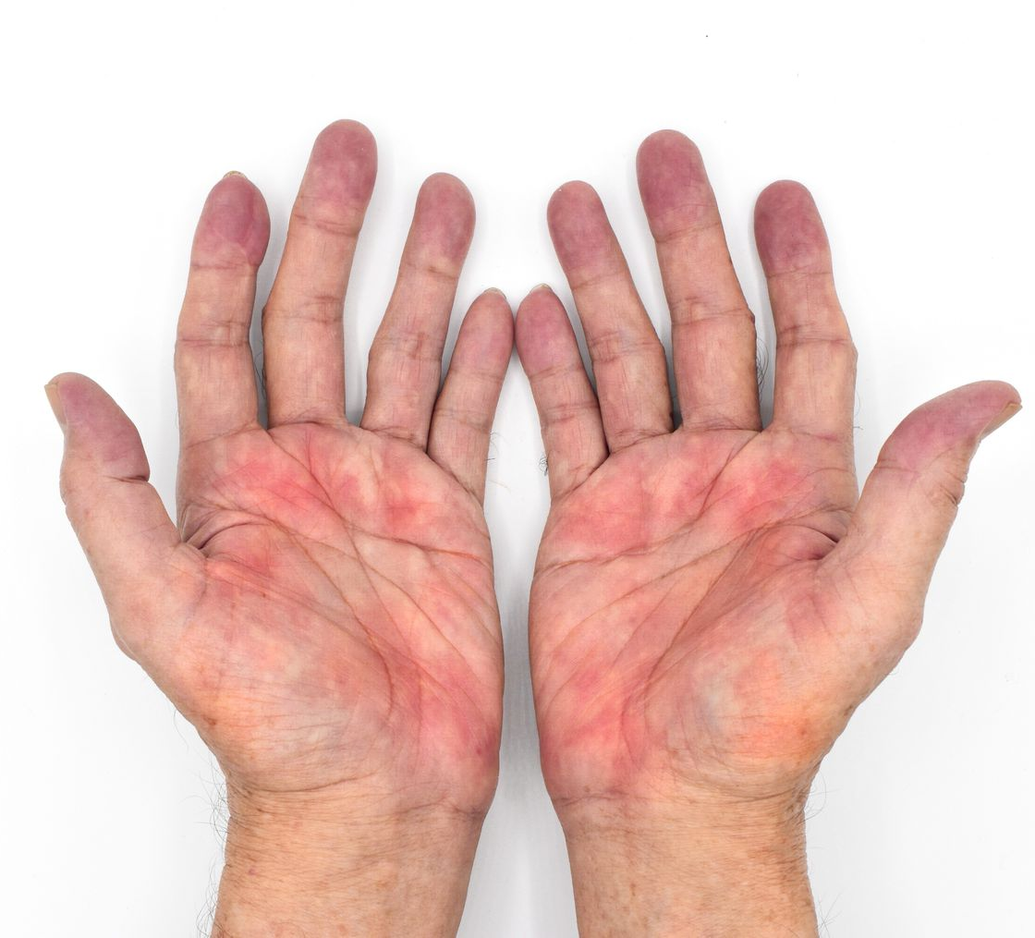
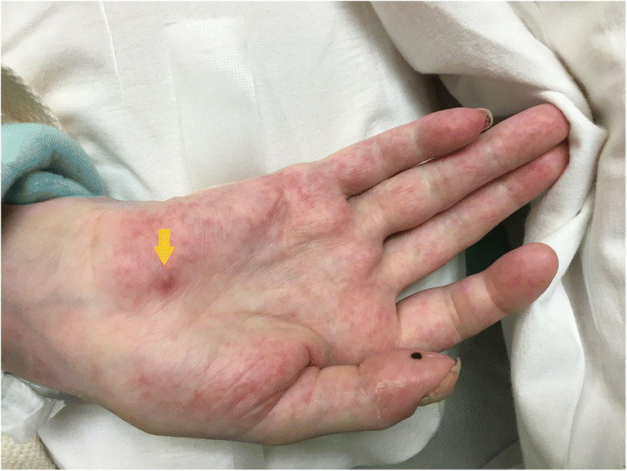
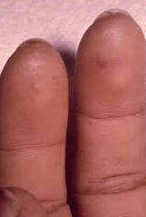
Notes:
Underlying medical conditions
Liver disease: Often called "liver palms," this is one of the most common causes of secondary palmar erythema. It is seen in about 23% of people with liver cirrhosis.
Rheumatoid arthritis (RA): More than 60% of people with this autoimmune disease may experience palmar erythema.
Endocrine disorders: An overactive thyroid (thyrotoxicosis) can cause red palms due to an increased metabolic rate, and the condition can also occur in people with diabetes mellitus.
Drug-induced: Some medications can cause palmar erythema, including topiramate, albuterol, amiodarone, gemfibrozil, and certain chemotherapy drugs.
Physiological and benign causes
Pregnancy: It is very common during pregnancy, affecting 30–70% of pregnant women, and is thought to be due to increased estrogen levels. The condition typically resolves after delivery.
Hereditary: Some people have a harmless genetic predisposition for red palms that can appear at birth or later in life.
Idiopathic: In some cases, there is no known cause for palmar erythema.
Osler nodes are painful, tender, raised, purplish-red nodules on the fingertips and toes, while Janeway lesions are painless, flat, red-to-brown macules or spots on the palms and soles

Slide 17
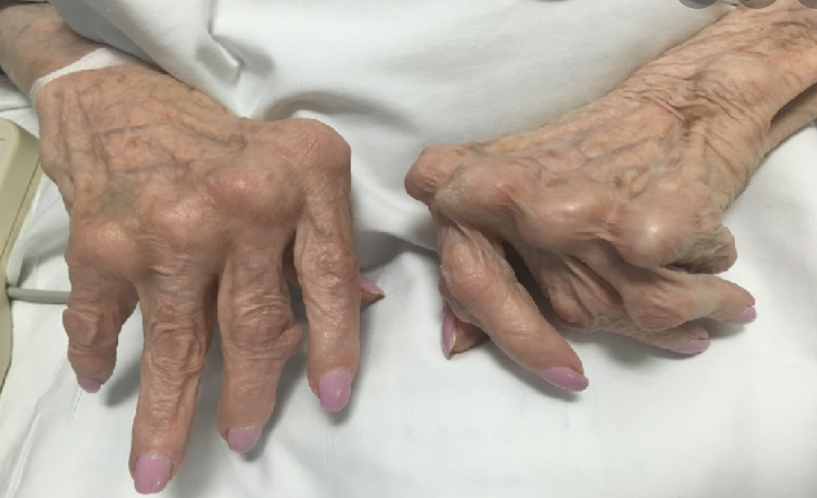
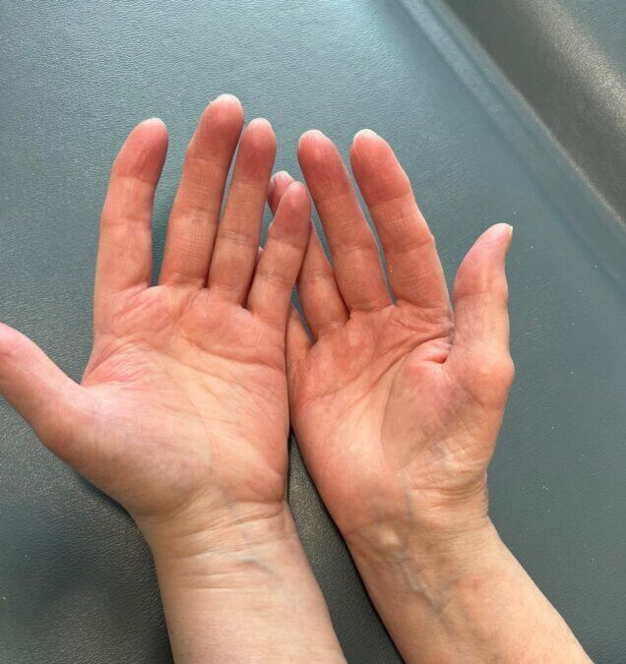

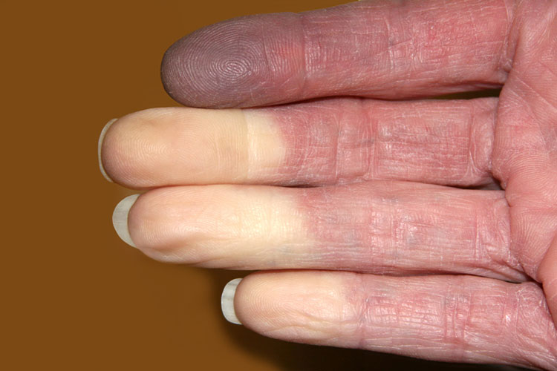
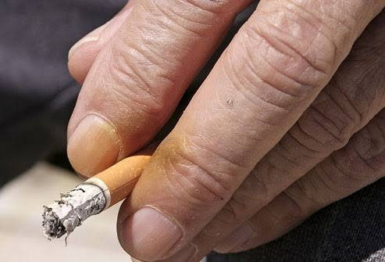

Slide 18
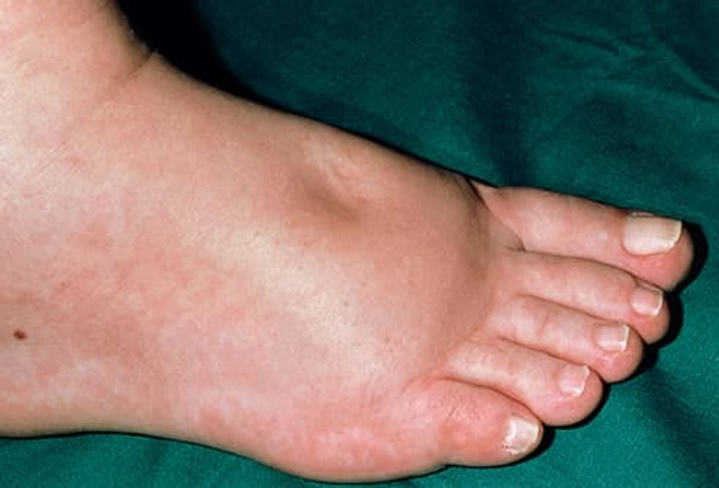
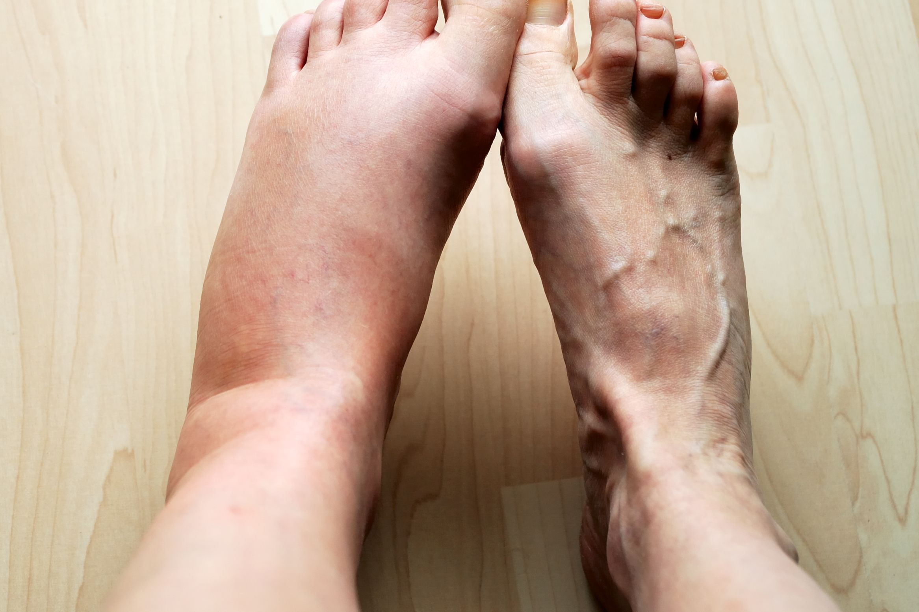

Slide 19
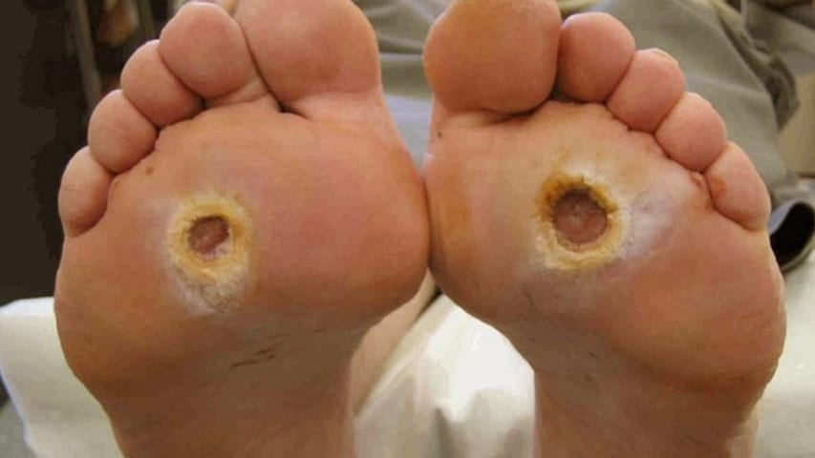
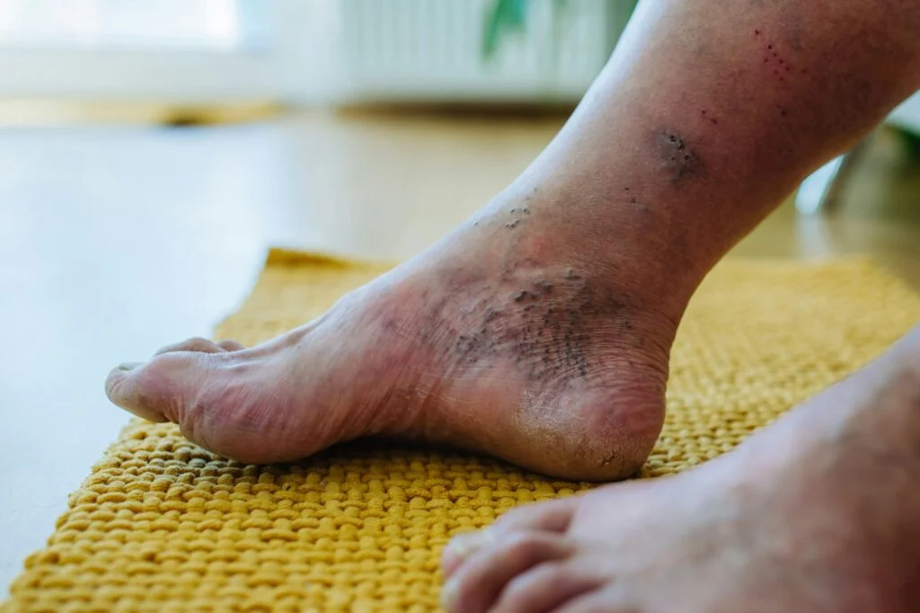
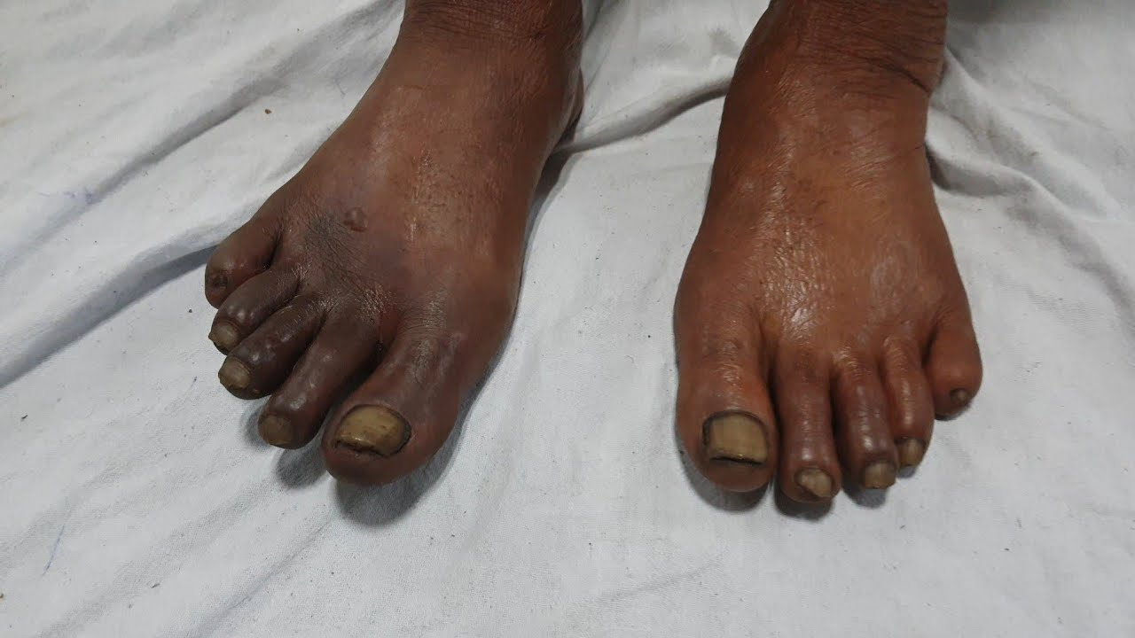
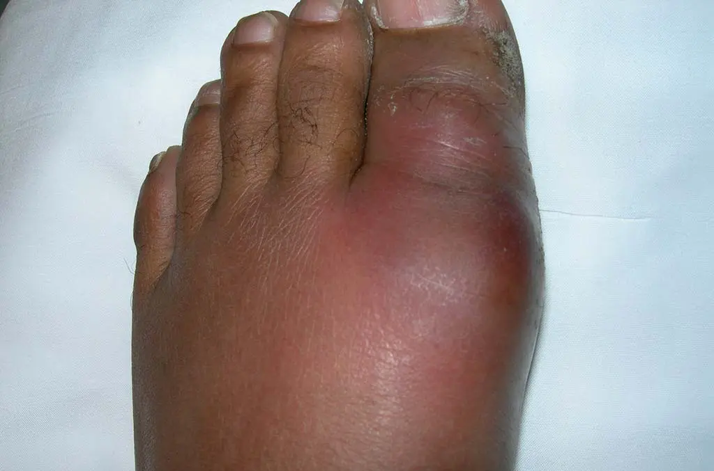

Slide 20
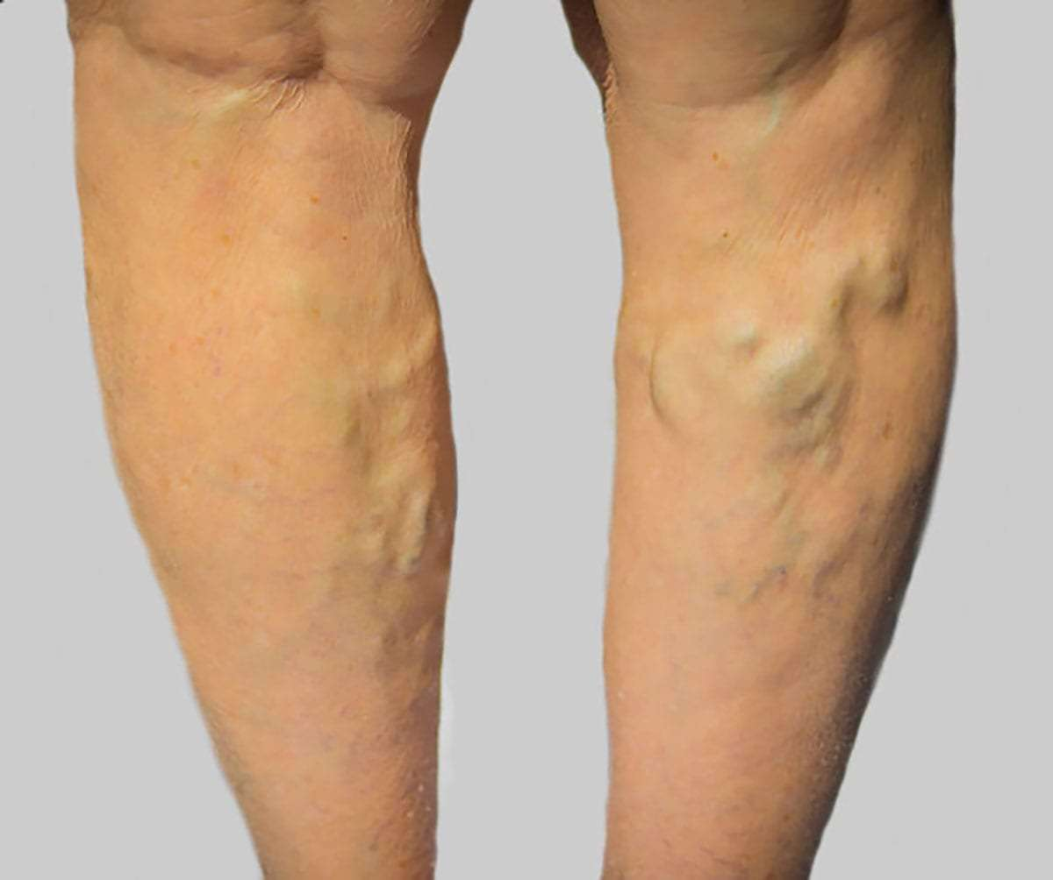
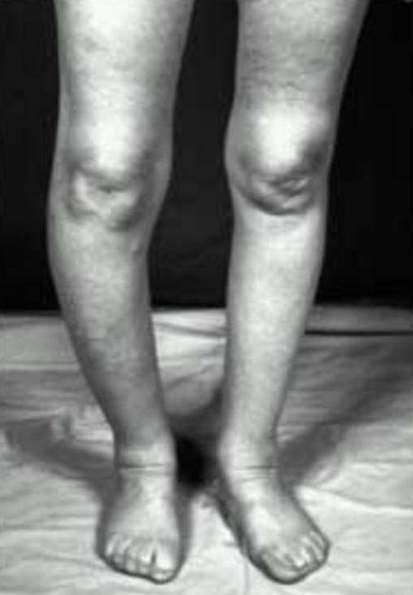
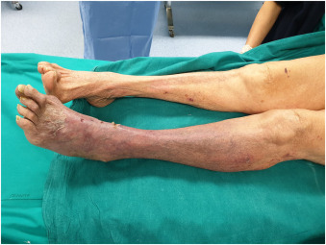

Slide 21
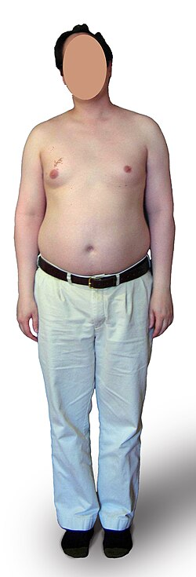


Notes:
Turner syndrome is a genetic condition that exclusively affects females and is caused by a missing or incomplete X chromosome
Klinefelter syndrome (KS) is a genetic condition in which males are born with an extra copy of the X chromosome, resulting in a 47,XXY karyotype instead of the typical 46, XY. This extra chromosome can affect physical, language, and social development. Symptoms vary widely, with some individuals having only subtle features that go undiagnosed
Tall stature, Gynecomastia, Reduced body hair, Weak muscles, Small testes, Infertility

